Slide 1
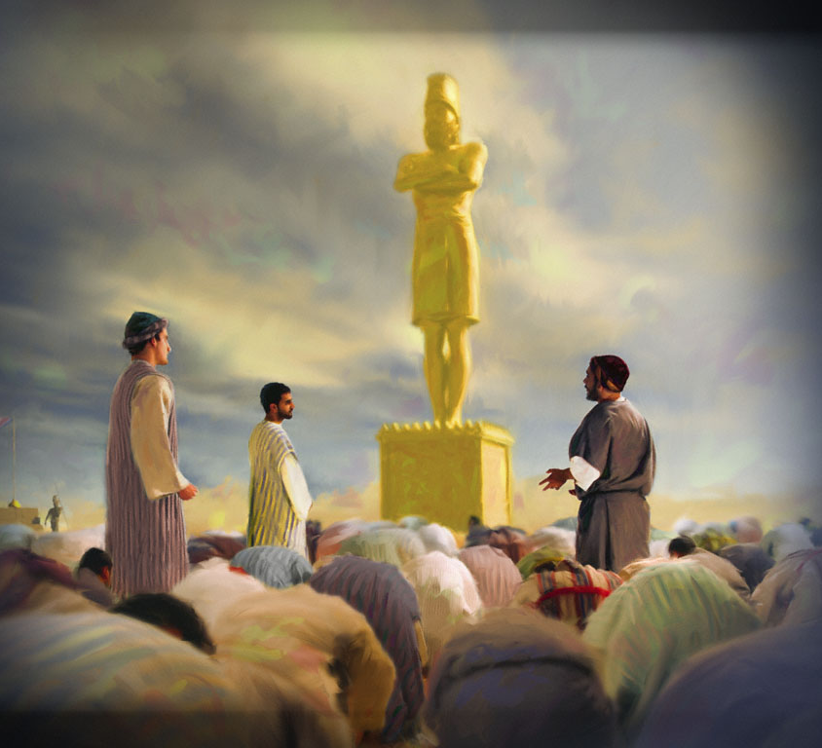
Rooted Worship
Daniel 3:1-18

Slide 2

Goal one of Discipleship:
Establish the Believer in Worship.

Slide 3
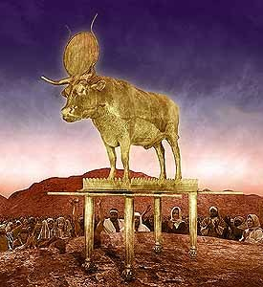
Exo 20:3 Thou shalt have no other gods before me.
Establish the Believer in Worship.

Slide 4
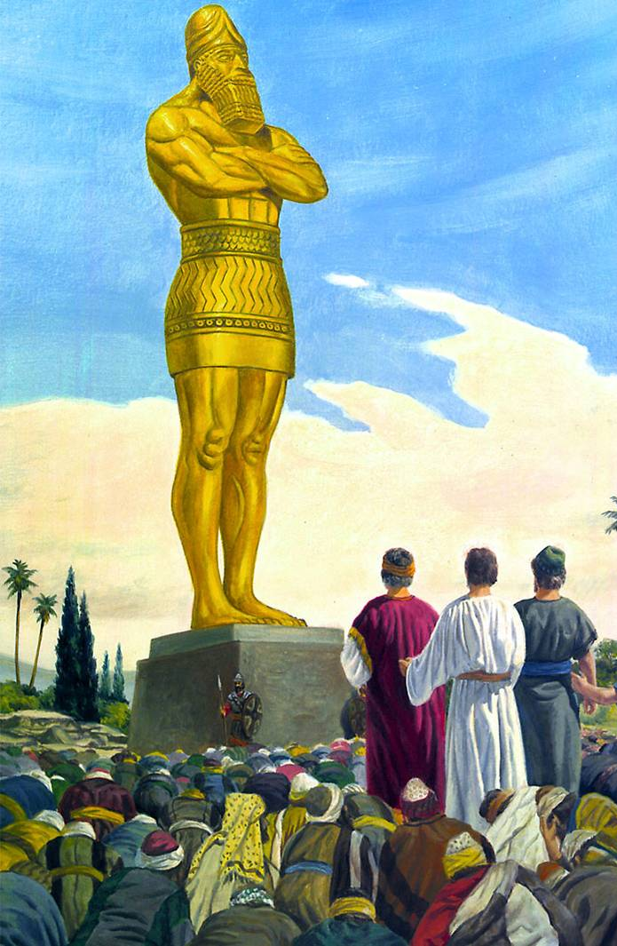
Gen 3:5 For God doth know that in the day ye eat thereof, then your eyes shall be opened, and ye shall be as gods, knowing good and evil.
Tactic 1: IMAGES
Satan’s Tactics to Acquire Worship

Slide 5
Exo 20:4 Thou shalt not make unto thee any graven image, or any likeness of any thing that is in heaven above, or that is in the earth beneath, or that is in the water under the earth: 5 Thou shalt not bow down thyself to them, nor serve them: for I the LORD thy God am a jealous God, visiting the iniquity of the fathers upon the children unto the third and fourth generation of them that hate me;
Tactic 1: IMAGES
Satan’s Tactics to Acquire Worship

Slide 6
Pro 27:20 Hell and destruction are never full; so the eyes of man are never satisfied.
1 John 2:16 For all that is in the world, the lust of the flesh, and the lust of the eyes, and the pride of life, is not of the Father, but is of the world.
Tactic 1: IMAGES
Satan’s Tactics to Acquire Worship

Slide 7
Php 4:11 Not that I speak in respect of want: for I have learned, in whatsoever state I am, therewith to be content.
Tactic 1: IMAGES
Satan’s Tactics to Acquire Worship

Slide 8
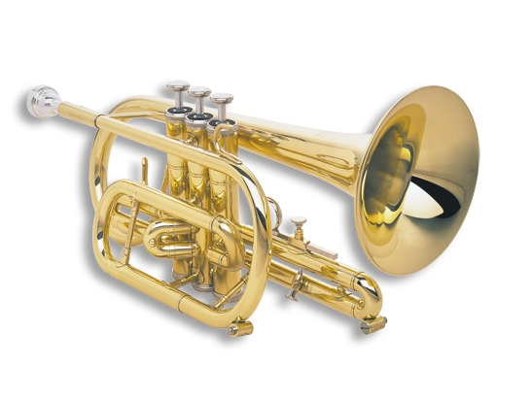
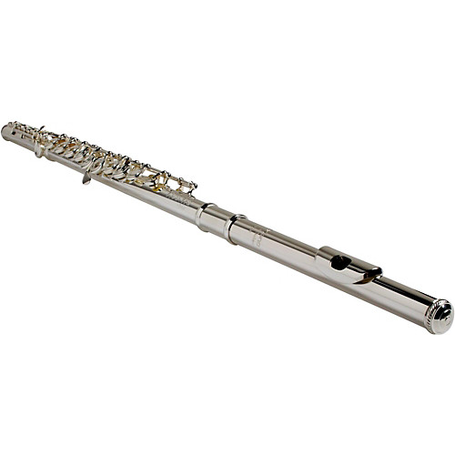
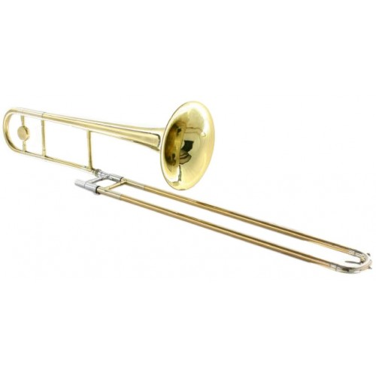
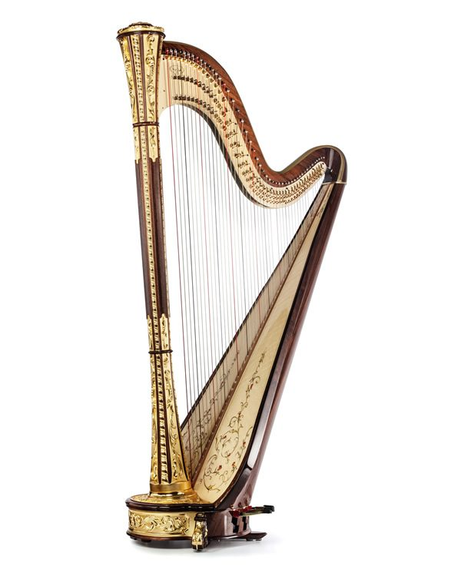
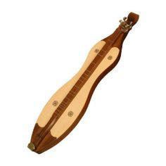
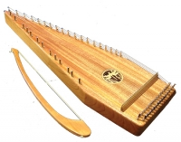
Tactic 1: IMAGES
Tactic 2: INSTRUMENTS
Satan’s Tactics to Acquire Worship

Slide 9

Tactic 1: IMAGES
Tactic 2: INSTRUMENTS
Tactic 3: INTIMIDATION
Satan’s Tactics to Acquire Worship

Slide 10
Tactic 3: INTIMIDATION
Rev 13:14 And deceiveth them that dwell on the earth by the means of those miracles which he had power to do in the sight of the beast; saying to them that dwell on the earth, that they should make an image to the beast, which had the wound by a sword, and did live. 15 And he had power to give life unto the image of the beast, that the image of the beast should both speak, and cause that as many as would not worship the image of the beast should be killed.
Satan’s Tactics to Acquire Worship

Slide 11
Tactic 3: INTIMIDATION
Est 3:5 And when Haman saw that Mordecai bowed not, nor did him reverence, then was Haman full of wrath. 6 And he thought scorn to lay hands on Mordecai alone; for they had shewed him the people of Mordecai: wherefore Haman sought to destroy all the Jews that were throughout the whole kingdom of Ahasuerus, even the people of Mordecai.
Satan’s Tactics to Acquire Worship

Slide 12
Tactic 3: INTIMIDATION
Psa 56:11 In God have I put my trust: I will not be afraid what man can do unto me.
Satan’s Tactics to Acquire Worship

Slide 13

Tactic 1: IMAGES
Tactic 2: INSTRUMENTS
Tactic 3: INTIMIDATION
Tactic 4: IMMERSION
Satan’s Tactics to Acquire Worship

Slide 14
Tactic 4: IMMERSION
Jdg 17:6 In those days there was no king in Israel, but every man did that which was right in his own eyes.
Satan’s Tactics to Acquire Worship

Slide 15

Tactic 1: IMAGES
Tactic 2: INSTRUMENTS
Tactic 3: INTIMIDATION
Tactic 4: IMMERSION
Tactic 5: INCRIMINATION
Satan’s Tactics to Acquire Worship

Slide 16
Tactic 5: INCRIMINATION
Dan 3:8 Wherefore at that time certain Chaldeans came near, and accused the Jews.
Satan’s Tactics to Acquire Worship

Slide 17
Tactic 5: INCRIMINATION
Hananiah – mercy of Yahweh
Shadrach – Aku’s command
Mishael – who is what God is
Meshach – who is like Aku
Azariah – whom Yahweh aids
Abednego – servant of Nebo
Satan’s Tactics to Acquire Worship

Slide 18

True Worship is Rooted in:
Fear of God.
1 Sam. 17:36 Thy servant slew both the lion and the bear: and this uncircumcised Philistine shall be as one of them, seeing he hath defied the armies of the living God.
Faith in God.
Faithfulness to God.

